Slide 1
IMPLEMENTATION OF APRIORI ALGORITHM USING HASHING CONCEPT

Slide 2
INTRODUCTION

Slide 3
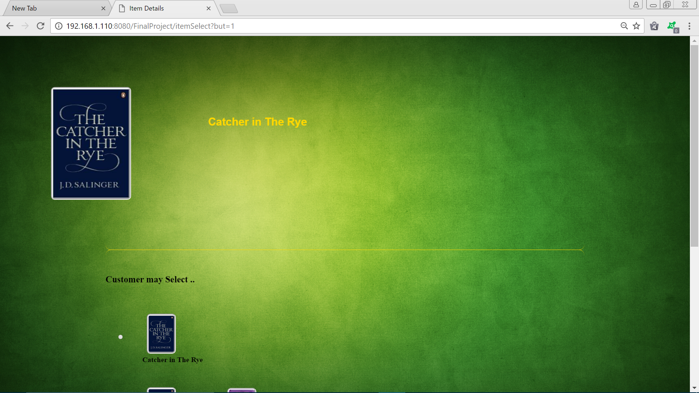

Slide 4
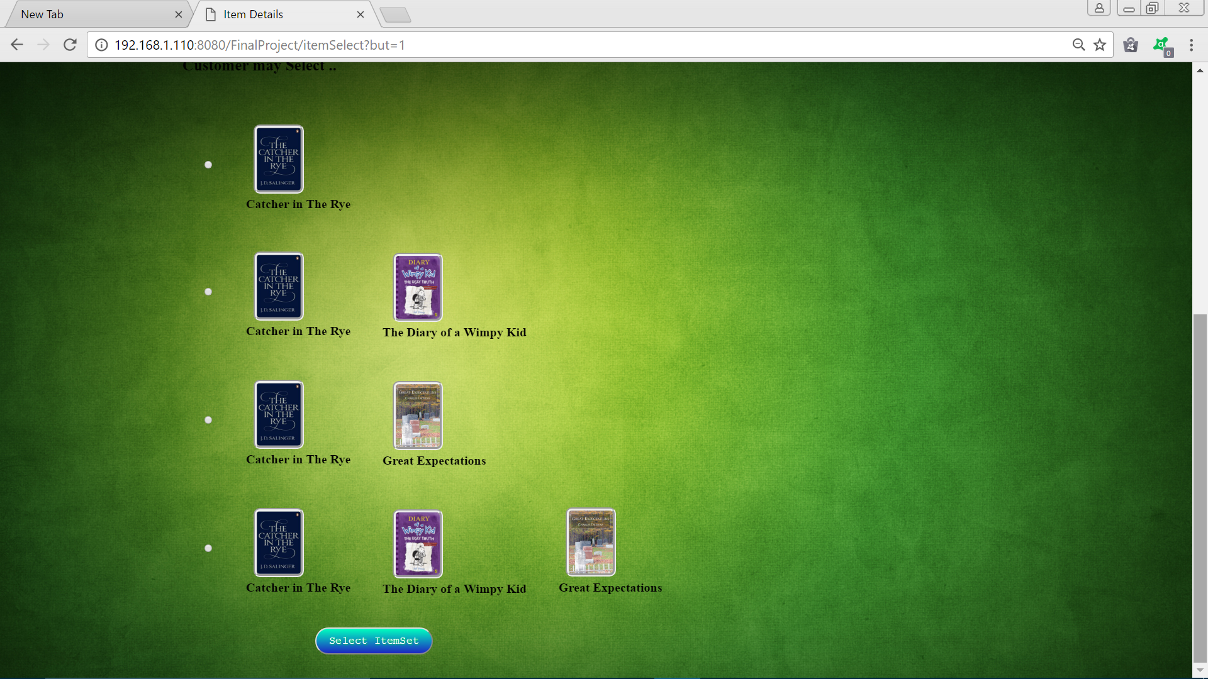

Slide 5
DATA WAREHOUSING

Slide 6
Data warehousing emphasizes the capture of data from diverse sources for useful analysis and access, but does not generally start from the point-of-view of the end user who may need access to specialized, sometimes local databases. The latter idea is known as the data mart.

Slide 7

DATA WAREHOUSING
USERS
DATA
SOURCES
STAGING
AREA
WAREHOUSE
DATA
MARTS
OPERATIONAL SYSTEM
META DATA
SUMMARY DATA
RAW DATA
OPERATIONAL SYSTEM
FILE SYSTEM
SALES,PURCHASING, INVENTORY ETC

Slide 8
DATA MINING AND DATA ANALYSIS

Slide 9
Data mining is the computing process of discovering patterns in large data sets involving various methods and algorithms.
The overall goal of the data mining process is to extract information from a data set and transform it into an understandable structure for further use.
Data analysis is the process of developing answers to questions through the examination and interpretation of data.
The basic steps in the analytic process consist of identifying issues, determining the availability of suitable data, deciding on which methods are appropriate for answering the questions of interest, applying the methods and evaluating, summarizing and communicating the results.

Slide 10


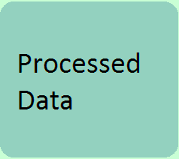



DATA MINING
patterns
Transformed data

Slide 11
APRIORI ALGORITHM

Slide 12
The Apriori Algorithm is an influential algorithm for mining frequent itemsets for boolean association rules.
This algorithm was mainly designed for the purpose of operating on those databases which include transactions (for example, collections of items bought by customers, or details of a website frequentation).

Slide 13
ALGORITHM:

Slide 14
GENERAL K-ITEMSET CANDIDATE (JOIN OPERATION)
CHECK SUPPORT
(PRUNING)
ITEMSET
N
THE SET OF K-1 ITEMSET IS NULL ?
END
FREQUENT ITEMSET
Y

Slide 15
FREQUENT 1 ITEMSET TABLE L1
TID
ITEM
ITEM
COUNT
ITEM
COUNT
1
1
2
1
2
T01
1,3,4
3
2
2
0
1
2
2
2
T02
2,3,5
1
2
3
3
T03
1,2,3,5
3
3
4
1
TRANSACTION TABLE T
5
2
1
5
2
0
CANDIDATE TABLE C1
CANDIDATE TABLE C3
ITEM
COUNT
ITEM
COUNT
ITEM
COUNT
1,2
1
2,3,5
2
1,3
2
1,3
2
2,3
2
1,5
1
2,5
2
2,3
2
ITEM
COUNT
3,5
2
2,5
2
2,3,5
2
3,5
2
FREQUENT 2 ITEMSET TABLE L2
FREQUENT 3 ITEMSET TABLE L3
CANDIDATE TABLE C2

Slide 16
APRIORI USING HASHING TECHNIQUE

Slide 17
The efficiency of the Apriori algorithm has been considerably improved by implementing it through the hashing concept.
The original Apriori algorithm makes use of the 2-itemset and 3-itemset candidate table (c2 & c3) which is replaced by the 2-itemset and 3-itemset hash tables(h2 and h3) respectively.
There is a considerable reduction in the complexity of the original Apriori algorithm due to the use of hashing concept.

Slide 18
TAKE THE CURRENT TRANSACTION STRING
UPDATE C1 USING CURRENT TRANSACTION STRING
UPDATE L1 USING C1 AND MINIMUM SUPPORT COUNT
APRIORI USING HASHING ALGORITHM
UPDATE H2 USING CURRENT TRANSACTION STRING AND L1
UPDATE L2 USING H2 AND MINIMUM SUPPORT COUNT
UPDATE H3 USING CURRENT TRANSACTION STRING AND L2
UPDATE L3 USING H3 AND MINIMUM SUPPORT COUNT

Slide 19
TRANSACTION TABLE T
CANDIDATE TABLE C1
FRQUENT ITEMSET TABLE L1
TID | ITEMS
T01 | 1,2,5
T01 | 1,2,5
T02 | 2,4
T03 | 2,3
T04 | 1,2,4
T05 | 1,3
T06 | 2,3
T07 | 1,3
T08 | 1,2,3,5
T01 | 1,2,5
T02 | 2,4
T03 | 2,3
T04 | 1,2,4
T01 | 1,2,5
T02 | 2,4
T01 | 1,2,5
T02 | 2,4
T03 | 2,3
T01 | 1,2,5
T02 | 2,4
T03 | 2,3
T04 | 1,2,4
T05 | 1,3
T01 | 1,2,5
T02 | 2,4
T03 | 2,3
T04 | 1,2,4
T05 | 1,3
T06 | 2,3
T01 | 1,2,5
T02 | 2,4
T03 | 2,3
T04 | 1,2,4
T05 | 1,3
T06 | 2,3
T07 | 1,3
ITEM | COUNT
ITEM | COUNT
1 | 5
2 | 6
3 | 5
2 | 2
2 | 4
2 | 3
1 | 3
2 | 4
2 | 5
1 | 1
2 | 1
3 | 0
4 | 0
5 | 1
1 | 4
2 | 5
3 | 4
1 | 1
2 | 2
3 | 0
4 | 1
5 | 1
1 | 5
2 | 6
3 | 5
4 | 2
5 | 2
1 | 2
2 | 4
3 | 1
4 | 2
5 | 1
1 | 1
2 | 3
3 | 1
4 | 1
5 | 1
1 | 3
2 | 4
3 | 2
4 | 2
5 | 1
1 | 3
2 | 5
3 | 3
4 | 2
5 | 1
1 | 4
2 | 5
3 | 4
4 | 2
5 | 1
FRQUENT ITEMSET TABLE L2
HASH TABLE H2
ITEM | COUNT
0 | 1 | 2 | 3
1,2 | 1
1,3 | 2
2,3 | 1
1,3 | 1
 | 1,3
1,2 | 1,3 |  | 2,3
 | 1,3

Slide 20
FREQUENT ITEMSET TABLE L3
HASH TABLE H3
0 | 1 | 2 | 3
 |  |  | 1,2,3
ITEM | COUNT
1,2,3 | 1

Slide 21
IMPLIMENTATION

Slide 22
3 TIER ARCHITECTURE
(Client End)PRESENTATION TIER:
The topmost level of application is the user interface. The main function of the interface is to translate tasks and results to something the user can understand.
(Application Layer)LOGIC TIER:
This layer coordinates the application, process commands, makes logical decisions and evaluations and performs calculations. It also moves and processes data between the two surrounding layers.
(DataBase Layer)DATA TIER:
Here information is stored and retrieved from a database or file system. The information is then passed back to the logic tier for processing and then eventually back to the user.

Slide 23


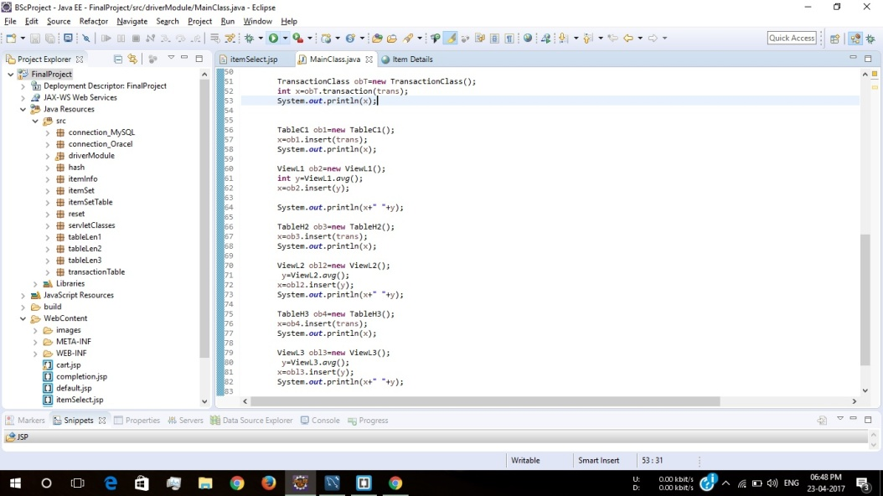
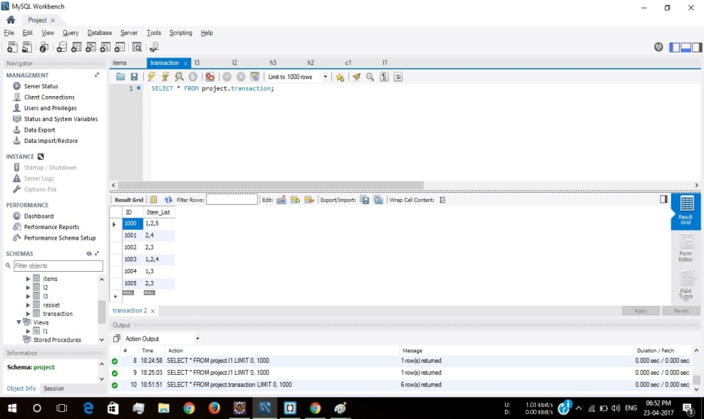
PRESENTATION TIER
LOGIC TIER
DATA TIER

Slide 24
SERVER SIDE MODEL

Slide 25
TAKE THE CURRENT TRANSACTION STRING
UPDATE C1 USING CURRENT TRANSACTION STRING
UPDATE L1 USING C1 AND MINIMUM SUPPORT COUNT
SERVER
UPDATE H2 USING CURRENT TRANSACTION STRING AND L1
UPDATE L2 USING H2 AND MINIMUM SUPPORT COUNT
UPDATE H3 USING CURRENT TRANSACTION STRING AND L2
UPDATE L3 USING H3 AND MINIMUM SUPPORT COUNT

Slide 26
PROCESS DIAGRAM

Slide 27
Steps of program execution
Y
DRIVER MODULE
isL1(item)
ResultSetTable. Insert(item)
N
TransactionClass. transaction(trans)
EXIT
BUY
isL2(item)
isL3(item)
Table C1.insert(trans)
ViewL1.insert(trans)
1

Slide 28
1
Table H2.insert( trans)
Itemset_2. combination( trans)
Itemset2.sort(trans)
No action
N
ViewL1.isL1(y)
&&
ViewL1.isL1(x)
Y
Hashing.setY(y)
Hashing.setX(x)
Hashing.getHash()
TableH2.runSql()
tableL2.insert(trans)
2
Steps of program execution

Slide 29
2
Steps of program execution
TableH3. insert(trans)
Itemset_3.combination(trans)
Itemset.sort(trans)
No Action
tableL2.isL2(z,y)
tableL2.isL2(z,x)
tableL2.isL2(x,x)
Hashing.setZ(z)
Hashing.setY(y)
Hashing.setX(x)
Hashing.getHash()
TableH3.runSql()
tableL3.insert(trans)
End

Slide 30
CLIENT SITE MODEL

Slide 31
START
ALL ITEMS ARE DISPLAYED
SERVER
USER SELECTS AN ITEM
2
COMBINATION OF ITEMS FOR A PARTICULAR SELECTION IS DISPLAYED
SELECT
N
EXIT
3
Y
1

Slide 32
1
2
3
BUY NOW?
N
Y
TRANSACTION IS COMPLETED, TRANSACTION ID IS GENERATED, TRANSACTION ID AND TRANSACTION STRING IS STORED IN DATABASE

Slide 33
GRAPHIC USER INTERFACE

Slide 34

USER SELECTS AN ITEM

Slide 35
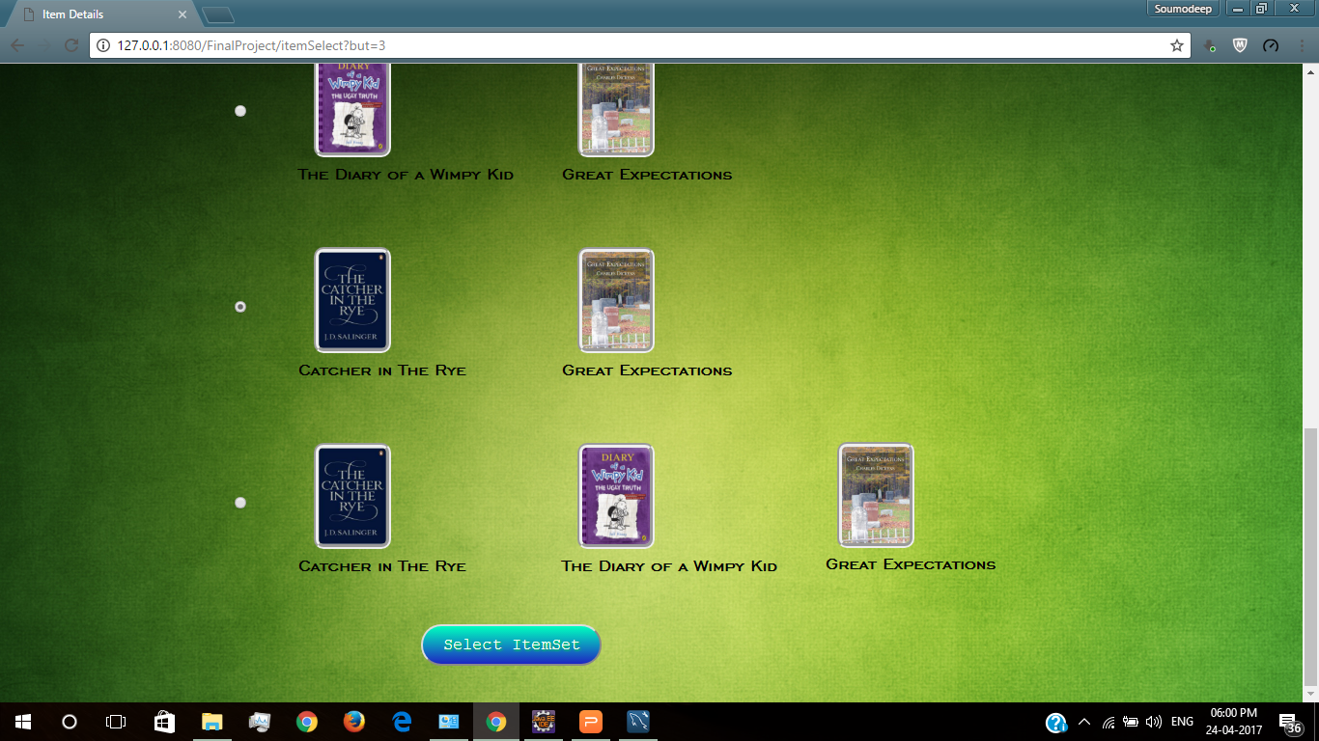
Result Set table is generated against the item and options are displayed
User is given a choice to opt for these options

Slide 36
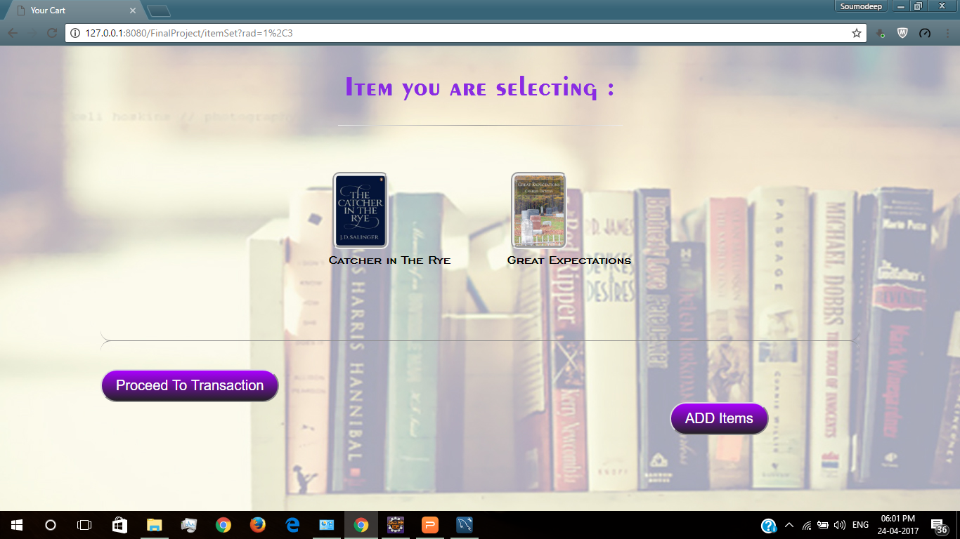
User can review the option he has selected for transaction
User can further add item to his transaction with the 'ADD item' Button

Slide 37
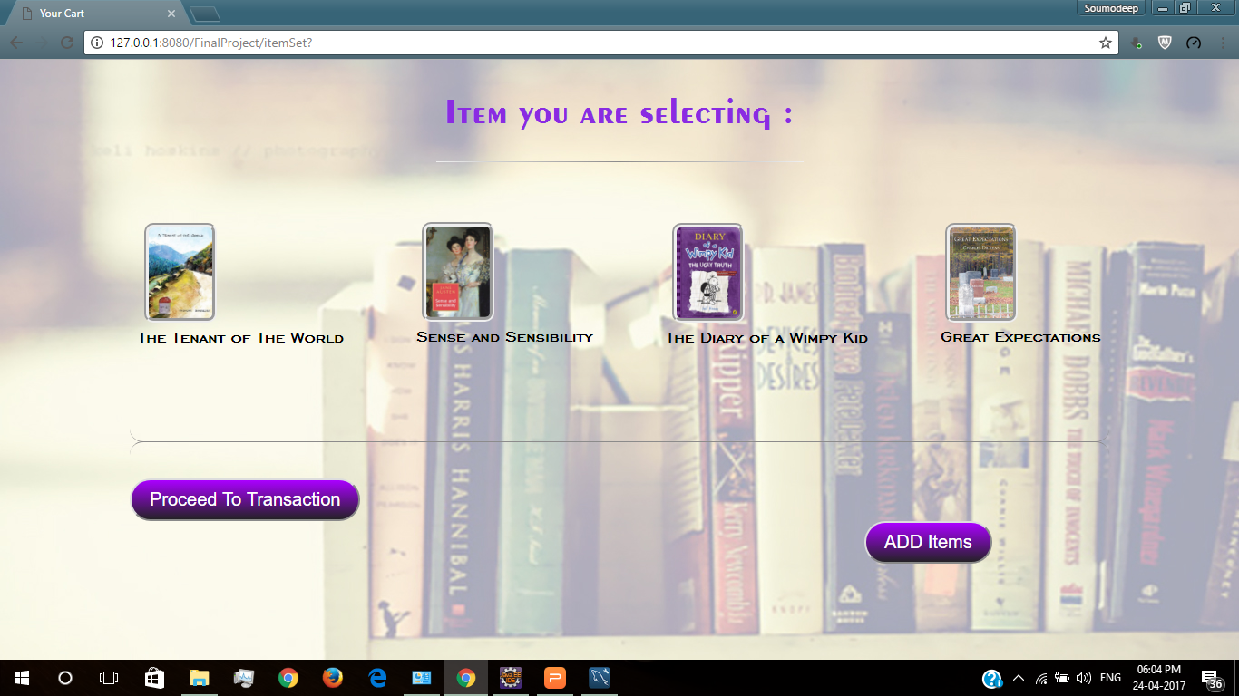
User finally proceeds with the transaction

Slide 38
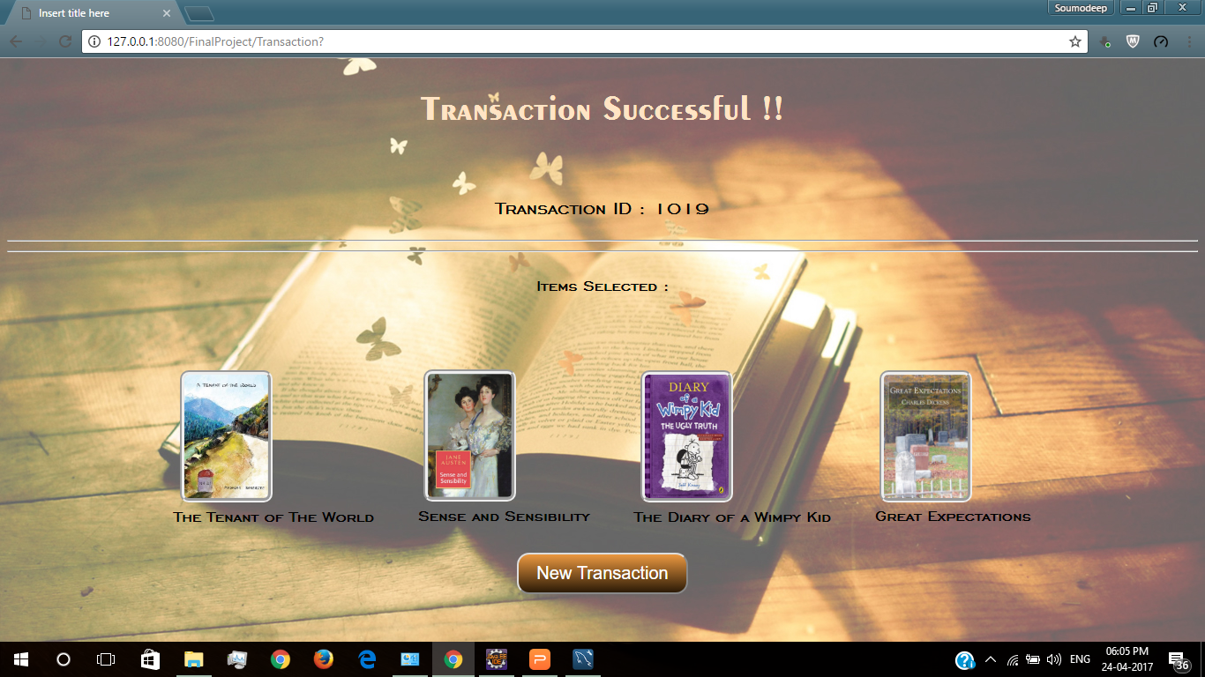
When the transaction is completed transaction id is generated and the entire algorithm runs on the server side making changes to all the tables in the data base

Slide 39
TEST CASE DESIGN AND RESULT COMPARISON

Slide 40
To check the system integrity of our software we have designed 4 test cases by changing 2 fields: i. Hash Function ii. Hash Table Size Thus the 4 test cases are arising by combining the above two factors are: i. Using concatenation hash function and keeping hash table size 13 ii. Using the general hash function and keeping hash table size 13 iii. Using concatenation hash function and keeping the hash table size 17 iv. Using the general hash function and keeping the table size 17

Slide 41
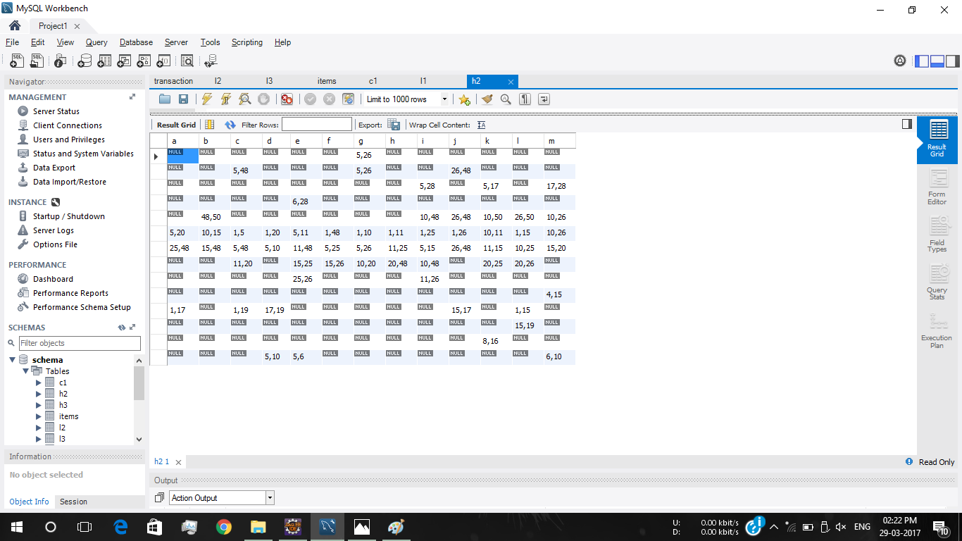
Concatenating y and x and then finding mod 13 in case of 2 itemsets

Slide 42
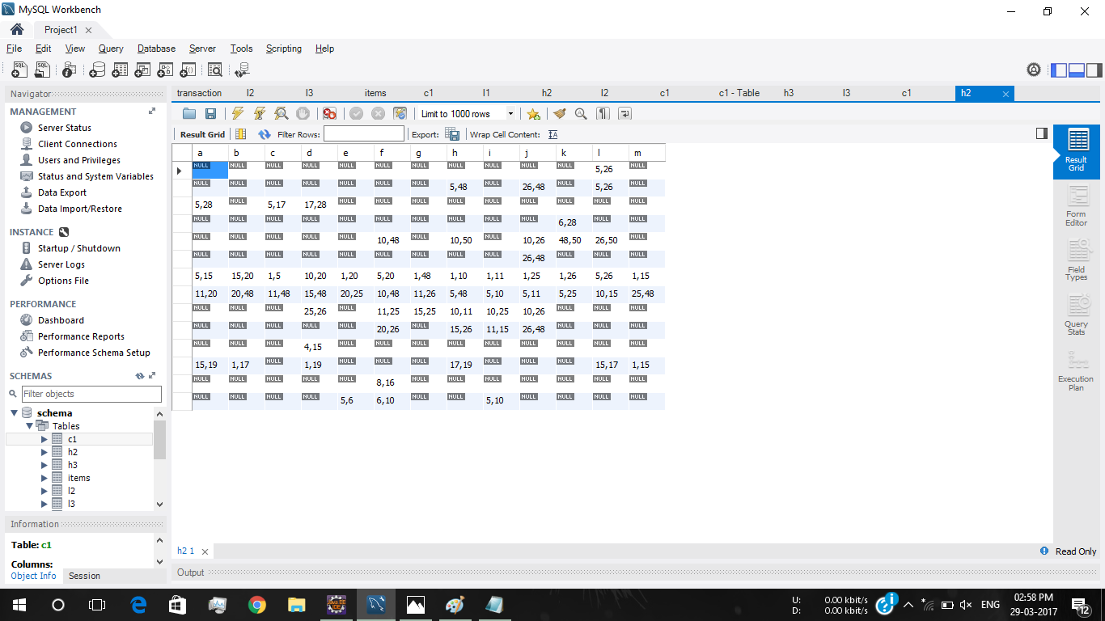
((y*10)+ x) mod 13 in case of 2 itemsets using table size 13

Slide 43
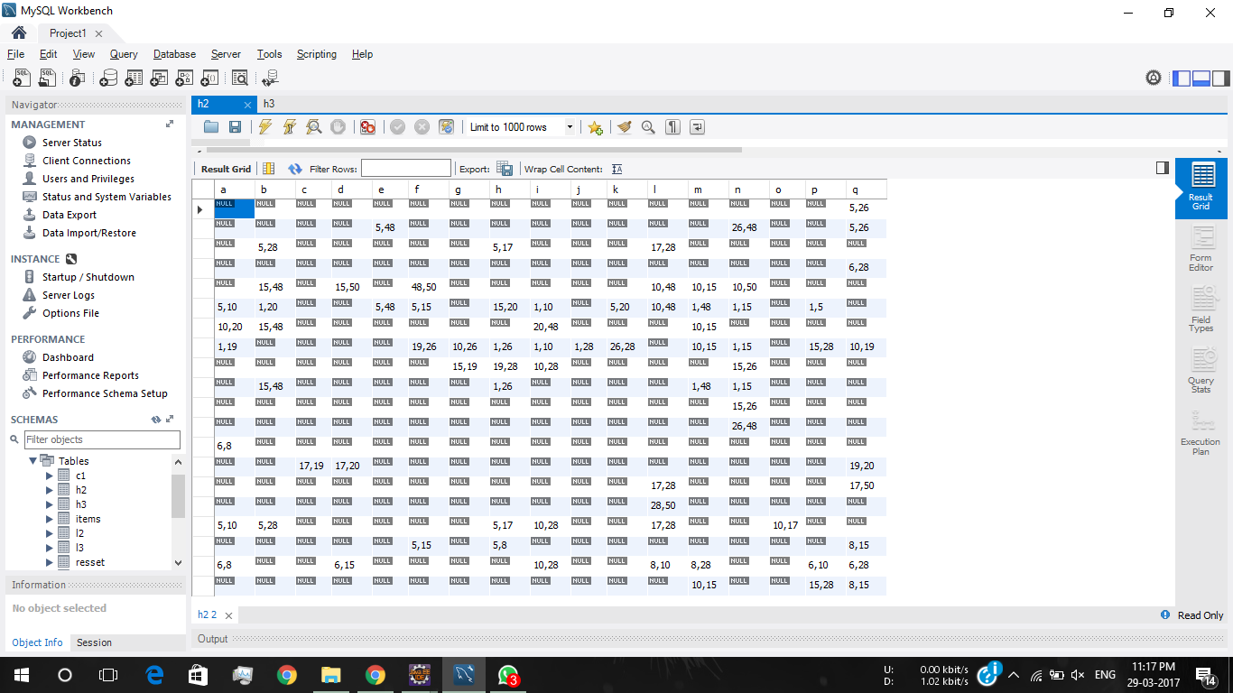
Concatenating y and x and then finding mod 17 in case of 2 itemsets using table size 17

Slide 44
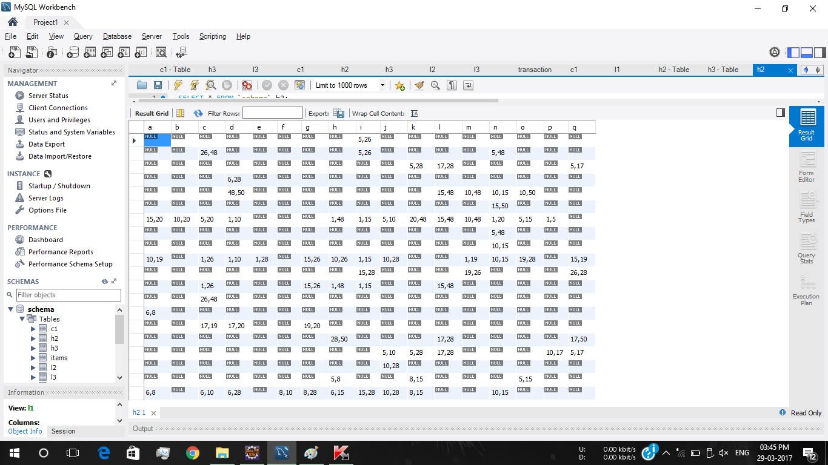
((y*10)+ x) mod 17 in case of 2 itemsets using table of size 17

Slide 45
On comparing the H2 table of size 17 and 13 for the general hash function we find that both of them are suffering quite less collisions but the H2 of size 13 is more compact and contains less NULL than that of size 17 H2. Thus for this set of transaction H2 of size 13 is preferred. But since the number of transactions will increase in the long run a hash table with bigger size will be preferred to reduce the collisions. In such a case the H2 of size 13 can be rehashed in H2 of size 17. The same holds for hash table H3 of size 13 and 17.

Slide 46
On comparing the Hash table H2 of size 13 for the two different hash functions we see that not much difference between the two tables in found. The number if elements remain quite the same only the hashed position is different. The same holds for the H3 table also. The same case is also true for Hash table of size 17.

Slide 47
CONCLUSION

Slide 48
LIMITATIONS OF THE APPLICATION
The transaction table is not used.
The hash function we are using is not the most optimised one. Several other hash functions can be used which are much more optimised and will result in lesser collision.
Generation of large number of null spaces in hash tables. The amount of null spaces increases with an increase in the transaction.
Backtracking is not possible.

Slide 49
FUTURE SCOPE
The coding is done in a structured manner by dividing it into modules. Thus improvements can be made to the project simply by adding new modules or by modifying the existing ones.
A better hash function can always be used which would reduce the number of null positions in the hash table thus improving the overall complexity of the algorithm.
Better algorithm to deal with the wastage of space in the hash tables.

Slide 50
REFERENCES
1. Sudhir Tirumalasetty, Aruna Jadda, Sreenivasa and Reddy Edara, “An enhanced Apriori Algorithm for Discovering Frequent Patterns with Optimal Number of Scans”, International Journal of Computer Science Issues 2015
2. Ashma Chawla and Kanwalvir Singh Dhindsa, “Implementation of Association Rule Mining using Reverse Apriori Algorithmic Approach”, International Journal of Computer Applications (0975 – 8887) Volume 93 – No.8, May 2014
3. Yanbin Ye and Chia-Chu Chiang, “A parallel Apriori Algorithm for Frequent Itemsets Mining” , Software Engineering Research, Management and Applications, 2006, Fourth International Conference.
4. Raffaele Perego, Salvatore Orlando and P. Palmerini, “Enhancing the Apriori Algorithm for Frequent Set Counting by Raffaele Perego”, Volume 2114 of the book series Lecture Notes in Computer Science (LNCS)

Slide 51
5. K.Vanitha and R.Santhi , “USING HASH BASED APRIORI ALGORITHM TO REDUCE THE CANDIDATE 2- ITEMSETS FOR MINING ASSOCIATION RULE”, Volume 2, No. 5, April 2011 Journal of Global Research in Computer Science
6. Nick Roussopoulos, “Materialized Views and Data Warehouses” , Department of Computer Science and Institute of Advanced Computer Studies, University of Maryland
7. Shikha Bhardwaj, Preeti Chhikara, Satender Vinayak, Nishant Pai, Kuldeep Meena, “Improved Apriori Algorithm for Association Rules”, International Journal of Technical Research and Applications e-ISSN: 2320-8163, www.ijtra.com Volume 3, Issue 3 (May-June
2015), PP. 238-240
8. Surajt Chaudhuri, Umeshwar Dayal in ACM Sigmond Record, “An overview of Data Warehousing and OLAP technology” ,Issue March 1997

Slide 52
THANK YOU

